Slide 1
The Common Toolkit Sascha Zelzer
10th Hackfest Jubilee

Slide 2
Welcome to the DKFZ!

Slide 4
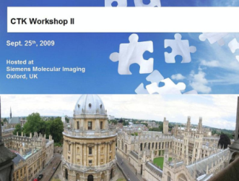
CTK Workshops
June 2009: Heidelberg, D (Kick-Off Meeting)
September 2009: Oxford, UK
November 2009: Chicago, USA
February 2010: San Diego, CA

Slide 5
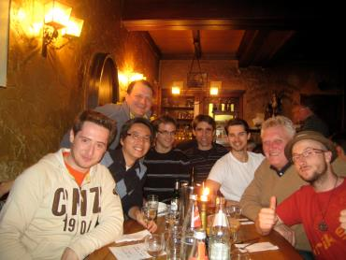
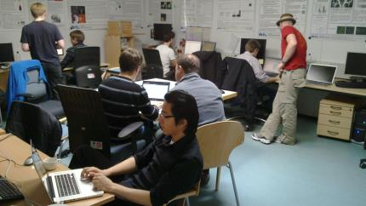
Pre-Hackfest, March 2010 (Heidelberg) – 9 Attendees
Initial Git repository
Coding guidelines
CMake superbuild
PythonQt
ZMQ & OpenIGTLink
Widgets
QtMobility
DICOM Indexer

Slide 6
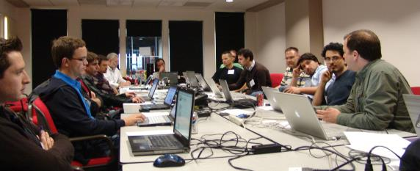
1st Hackfest, May 2010 (Georgetown) – 19 Attendees
CTK Buildsystem & Integration
Plugin Framework
CLI discussions
Event Bus
OpenInventor scene graphs in VTK
CTK Widgets
DCMTK CMake & Indexer + SCU

Slide 7
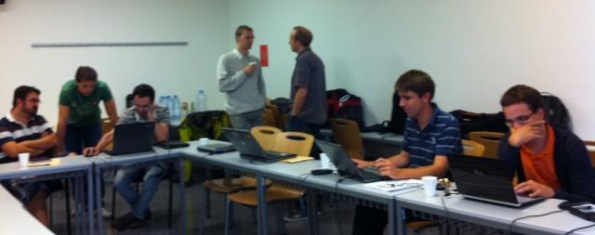
2nd Hackfest, September 2010 (Barcelona) – 12 Attendees
DICOM App Hosting
CLI
DICOM demo app (Q/R)
DCMTK fork
MAF event bus
App Launcher

Slide 8
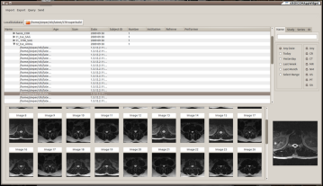
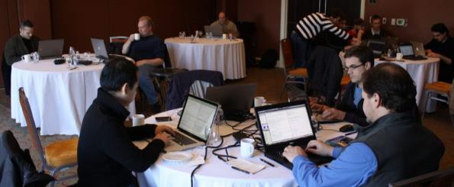
3rd Hackfest, February 2011 (Chapel Hill) – 12 Attendees
DICOM App Hosting
DICOM widgets & demo app
Event bus
Doxygen docs

Slide 9
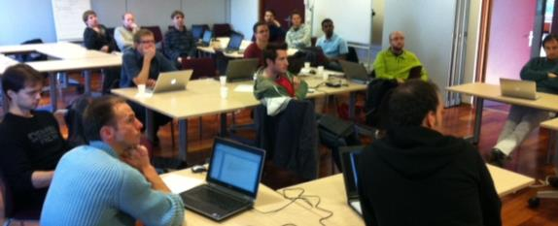
4th Hackfest, Nov. 2011 (Sophia-Antipolis) – 12 Attendees
DICOM App Hosting
CLI
XML Parser
XML Schema
UI generation
Hosted app
DICOM query
Unit testing
Build system

Slide 10
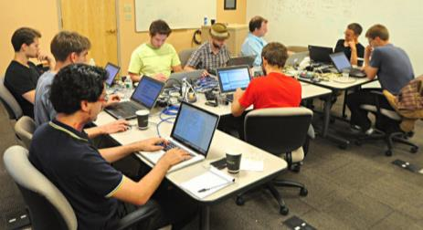
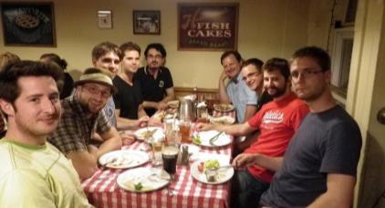
5th Hackfest, July 2012 (Boston) – 10 Attendees
DICOM App Hosting
DICOM classes
DCMTK update
CLI library
Packaging (Debian)

Slide 11
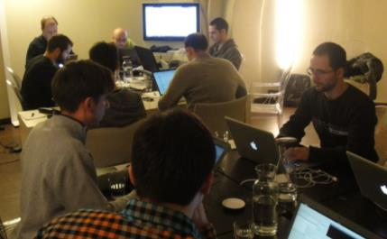
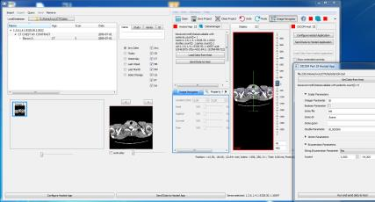
6th Hackfest, December 2012 (Bologna) – 16 Attendees
CLI integration
Slicer
MAF
MedInria
XNAT library (qRestAPI)
Qt widgets
Qt5 compatibility
Debian packaging
DICOM library
DICOM App Hosting example

Slide 12
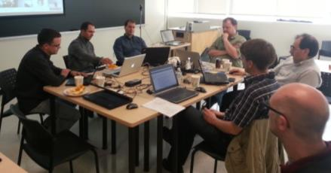
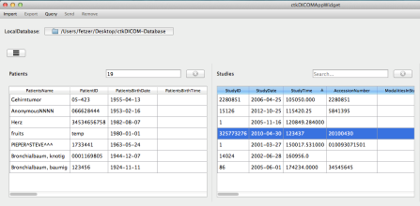
7th Hackfest, May 2013 (Kingston) – 11 Attendees
DICOM App Hosting Integration (Slicer/MITK)
Qt Widgets & Qt5
QtTesting library
XNAT library
CLI XML generation
DICOM
dcmtk CMake
RT Discussion
Browser widget

Slide 13
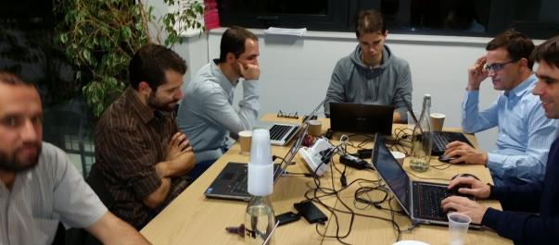
8th Hackfest, November 2013 (London) – 10 Attendees
XNAT library
CLI library
Debian packaging
DICOM
App Hosting
Database backend
Browser widget

Slide 14
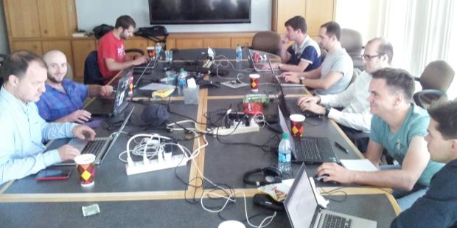
9th Hackfest, May 2014 (St. Louis) – 10 Attendees
DICOM
Web service (WG27)
dcmjs.org
dcmtk CMake patches
App Hosting interoperability
XNAT library
Qt5 compatibility
Build system & TravisCI

Slide 15
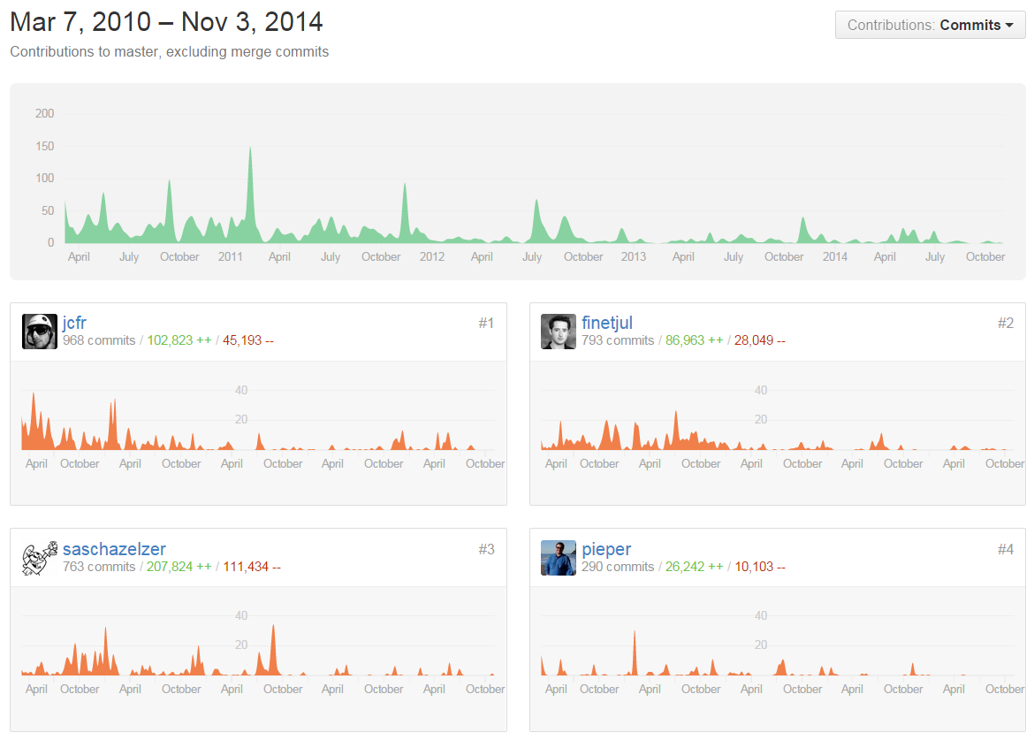

Slide 16
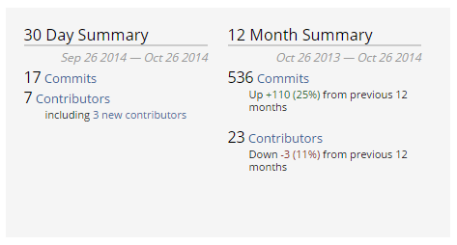
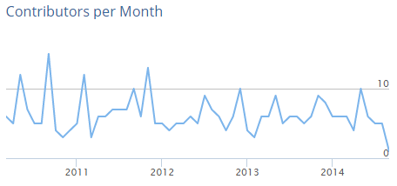
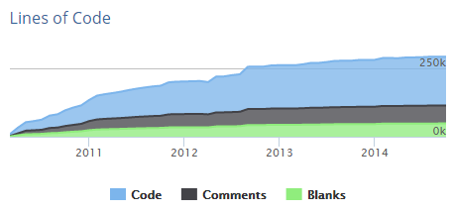
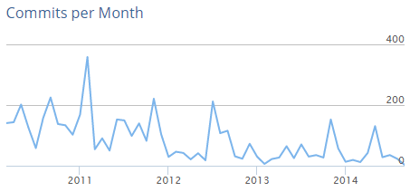

Slide 17
Source code evolution video:
https://vimeo.com/110983539

Slide 18
Thank you for your attention!

